Slide 1
Top billionaire data analysis
Name : Sanjana Sorani
Class: BCA(4-C)
Roll NO: 92300527147
Grop no:20
R project

Slide 2
This code creates a horizontal barplot of the top ten billionaires’ net worth. It labels each bar with its corresponding value for better clarity. The bars are labeled with the names of the billionaires and the actual net worth values are shown to the right of the bars.
#This R script creates a horizontal bar chart that visualizes the net worth of the top ten billionaires in the world. The chart is saved as a PNG file for reporting or presentation purposes.
# Data
A <- c(211,180,114,107,106,104,94.2,93.5,83.3,80.7)B <- c("Bernard Arnault","Elon Musk","Jeff Bezos","Larry Ellison","Warren Buffett", "Bill Gates", "Michael Bloomberg", "Carlos Slim Helu & family", "Mukesh Ambani","Steve Ballmer")
# Save plot as
PNGpng("top_billionaires.png", width = 900, height = 600)
# Create barplot and store bar midpointsbp
<- barplot(A, names.arg = B, horiz = TRUE, xlab = "Net Worth (in billions)", col = "blue", main = "Top Ten Billionaires", las = 1, cex.names = 0.7)
# Add net worth values at end of barstext(x = A + 5, y = bp, labels = A, cex = 0.8, col = "black")# Finish savingdev.off()

Slide 3
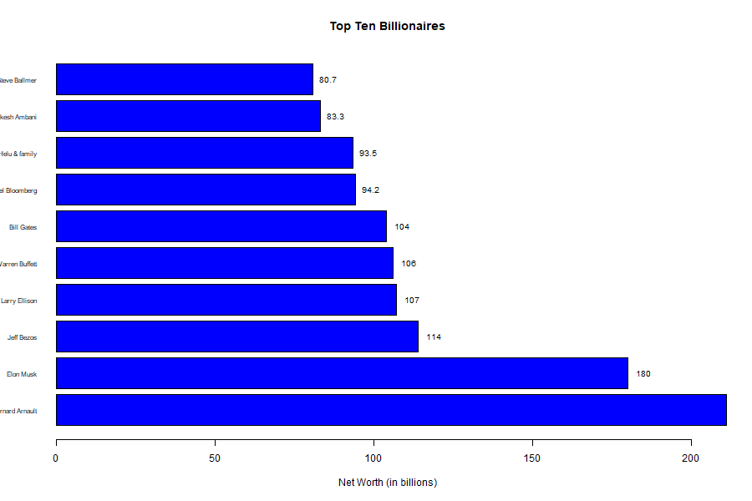

Slide 4
This code creates a visually enhanced pie chart showing the top three countries by value (e.g., net worth). Each slice displays both the country name and its percentage contribution to the total. Let me know if you want to customize colors or add a legend!
install.packages("plotrix") # Run this only once
# Data
A <- c(211, 180, 114)
labels <- c("France", "US", "Mexico")
pct <- round(A / sum(A) * 100)
labels_with_pct <- paste(labels, pct, "%")
# 3D Pie Chart
pie3D(A, labels = labels_with_pct, explode = 0.1, main = "Top Three Countries")

Slide 5
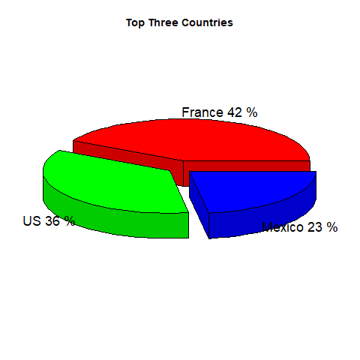

Slide 6
Here's a detailed explanation hich creates a vertical barplot of top industry net worths, along with data labels on each bar. This script creates a clear vertical barplot of net worths by industry/company. It includes: Yellow bars Vertical x-axis labels Blue value labels placed on top of each bar
# Data
A <- c(211, 180, 114, 107, 106, 104, 94, 93, 83, 80) # Net worth
B <- c("LVMH", "Tesla", "SpaceX", "Amazon", "Oracle","Berkshire Hathaway", "Microsoft", "Bloomberg LP",
"Telecom", "Diversified")
bp <- barplot(A,names.arg = B,xlab = "Source names",ylab = "Net worth (in billions)",col = "yellow",main = "Top Industry Net Worth",las = 2)
# Add data labels on top of each bar
text(x = bp, y = A, label = A, pos = 3, cex = 0.8, col = "blue")

Slide 7
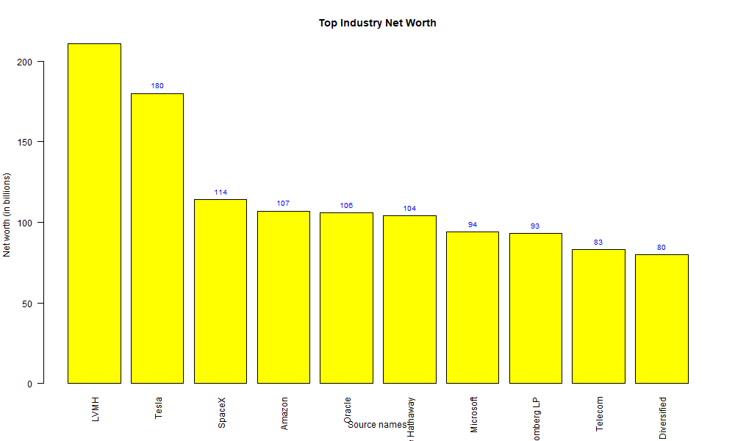

Slide 8
display the country names as X-axis labels. Your original code creates a red line+point chart of net worth values, but doesn’t label the countries. By modifying the x-axis, you can make the chart more informative by showing the actual country names.
#data
V <- c(211,180,114,107,106)
Y <- c("france","us","maxico","india","spain")
plot(V,type="o",col ="red",xlab ="countryn",ylab ="net of worth",main ="top country chart")

Slide 9
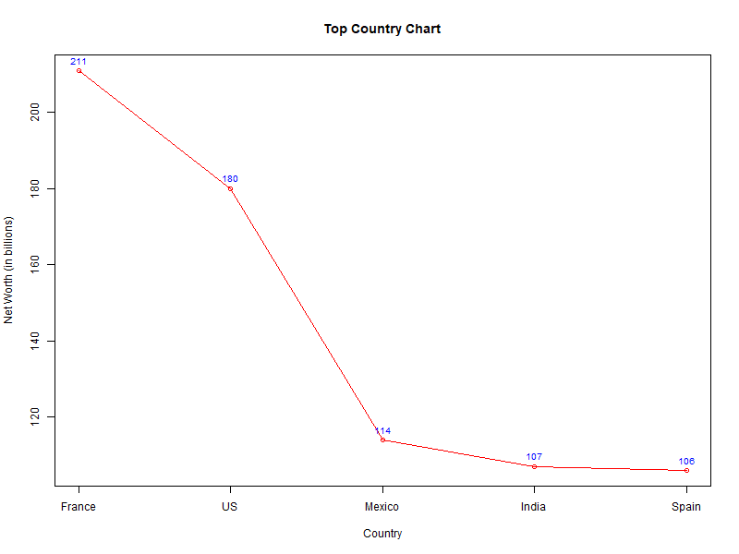

Slide 10
This code creates a clean barplot showing the net worths of the top five billionaires, with: Blue bars Labeled names on the x-axis Net worth numbers displayed above each bar
# Data
<- c(211,180,114,107,106,104,94.2,93.5,83.3,80.7)B
<- c("Bernard Arnault","Elon Musk","Jeff Bezos","Larry Ellison","Warren Buffett", "Bill Gates", "Michael Bloomberg", "Carlos Slim Helu & family", "Mukesh Ambani","Steve Ballmer")
# Save plot as
PNGpng("top_billionaires.png", width = 900, height = 600)
# Create barplot and store bar midpointsbp
<- barplot(A, names.arg = B, horiz = TRUE, xlab = "Net Worth (in billions)", col = "blue", main = "Top Ten Billionaires", las = 1, cex.names = 0.7)
# Add net worth values at end of barstext
(x = A + 5, y = bp, labels = A, cex = 0.8, col = "black")# Finish savingdev.off()

Slide 11
